Slide 1

Child safety monitoring And Notification

Slide 2
Team members
P.Kaviya Dharshini
R..Yuvasankari
P.Jeya Lakshmi
R.Poovarasan
R.Ujwal

Slide 3
ABSTRACT
The overall percentage of child abusements filed nowadays in the world is about 80%, out of which 74% are girl children and the rest are boys. For every 40 seconds, a child goes missing in this world. Children are the backbone of one’s nation, if the future of children was affected, it would impact the entire growth of that nation. Due to the abusements, the emotional and mental stability of the children gets affected which in turn ruins their career and future. These innocent children are not responsible for what happens to them. So, parents are responsible for taking care of their own children. But, due to economic condition and aims to focus on their child’s future and career, parents are forced to crave for money. Hence, it becomes difficult to cling on to their children all the time. In our system, we provide an environment where this problem can be resolved in an efficient manner. It makes parents to easily monitor their children in real time just like staying beside them as well as focusing on their own career without any manual intervention.

Slide 4
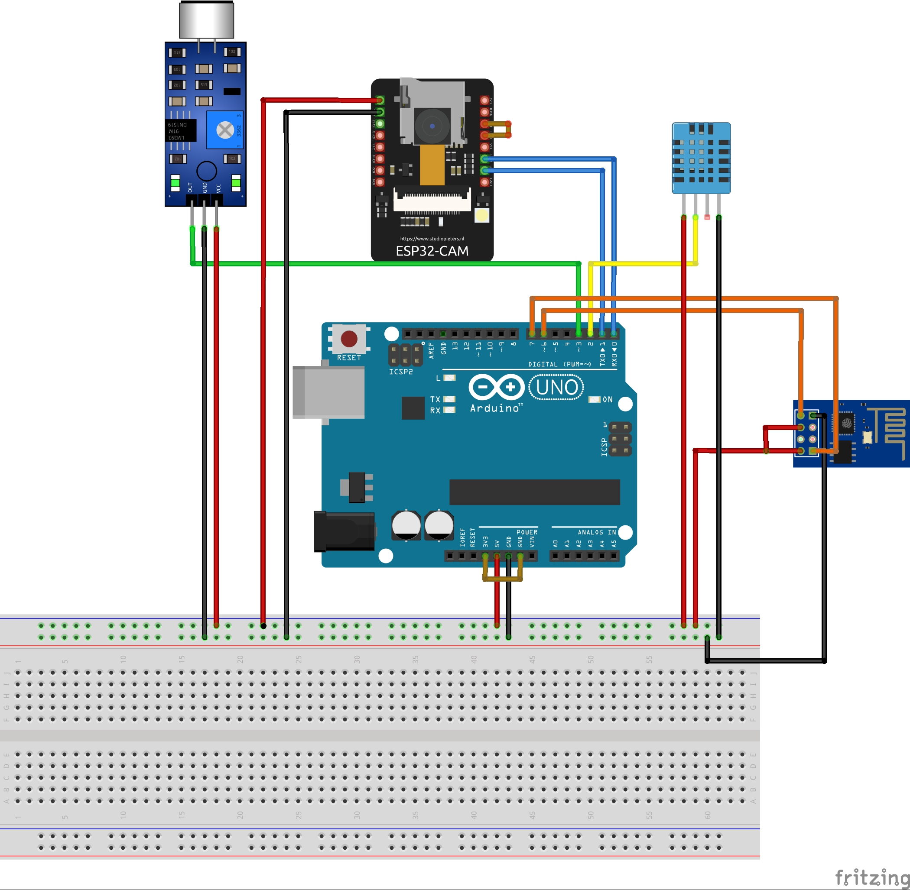
Block Diagram

Slide 5
Methodology
Gathering information: previously there were approaches that were implemented tosolve child monitoring system. Many schools and families use different types ofapproaches to locate and monitor childrent
➢Hard ware and Software: the hard ware construction and software implementation withArduino software
Modeling: Based on the information we have gathered through interviewing theproblems of the current monitoring system in our context designed the flow chart,system design and ER diagram for the project.
➢Evaluation and Conclusion: Based on the proposed system conclusion and evaluationof work is done

Slide 6
Working.
proposed system consists of Raspberry Pi microprocessor in which all other sensors, GPS and GSM are integrated.
The users are required to register using their credentials to use the application. The device will be given to the children for monitoring them regularly.
We will feed the boundary value while writing code for the system and we control it using GPS for that device which is also known as Geo Fencing. These data are stored in the server.

Slide 7
If the device moves, out of that boundary the server transfers an alert call by activating the GSM, to the user. The live location of the device will be updated in the server and pinged in the website for every few seconds. The server side coding was written in PHP and the controller side coding was written in Python. The user will receive an alert call and after entering the login ID and password, they can check the live location through GPS, which was updated in the application. When giving boundary for the school unit, we can also maintain attendance by updating the entry and exit of the child, in and out, of school in the application.

Slide 8
We feed specific threshold values for sensors like temperature and pulse in which, if the device exceeds those threshold values or if the device gets exposed to abnormal condition then those values tend to be updated in the server
The server compares the currently obtained values with the coded threshold values, if they are beyond the threshold value, it generates an alert message through GSM.
The alert messages are delivered to specified users in the form of SMS and the user can be able to login to the application to check the status and updated information.

Slide 9
After receiving the alert messages, if the user wants to visually check the status of the child, they are required to enter specific IP address of that camera for the first time before syncing and can be able to watch the live streaming videos which are updated to the server, for further uses they can directly view. The microprocessor is used to control all these actions and the alert was done by checking for specific user of that device in the database

Slide 10
Uses
With this motivation, a smart IoT device for child safety and tracking is developed to help the parents to locate and monitor their children.
The system is developed using LinkIt ONE board programmed in embedded C and interfaced with temperature, heartbeat, touch sensors and also GPS, GSM & digital camera modules.

Slide 11
Advantages
No need for routine survey
Ensuring safety and comfort
Efficiency
Accuracy
Mobility

Slide 12
Conclusion
This research demonstrates Smart IoT device for child safety and tracking helping the parents to locate and monitor their children.
If any abnormal values are read by the sensor then an SMS is sent to the parents mobile and an MMS
indicating an image captured by the serial camera
.It is also sent.The future scope of the work is to implement the IoT device which ensures the complete solution for child safety problems.

